Slide 1

AUTO Charging system
Korea University alumni ARTIFICIAL INTELLIGENCE club
Bruce Kwang kyun kim, han dong lim, john soohong sung, and gunhee han

Slide 2
Purpose of the project
Bring solutions to technical challenges in electric vehicle market and translate into business

Slide 3
Marketability

Slide 4
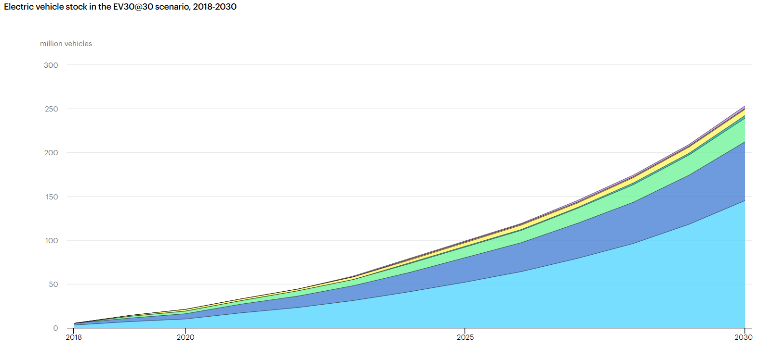
Electrification Outlook
In 2030, more than 250 million vehicles would need their batteries to be charged.
https://www.iea.org/reports/global-ev-outlook-2020

Slide 5
Charging demands analysis
 | Charging Time | Battery Life Cycle
Quick Charge | Tesla Model Y: 18min OEM average: 30 ~ 40min | Cycle decreases rapidly
Standby(normal) Charge | Average 6hrs | Cycle decreases slowly
User Demand
Charge batteries without reducing battery life at anytime
Charging Stations Owner Demand
→ Rent vacant charging stations and earn money

Slide 6
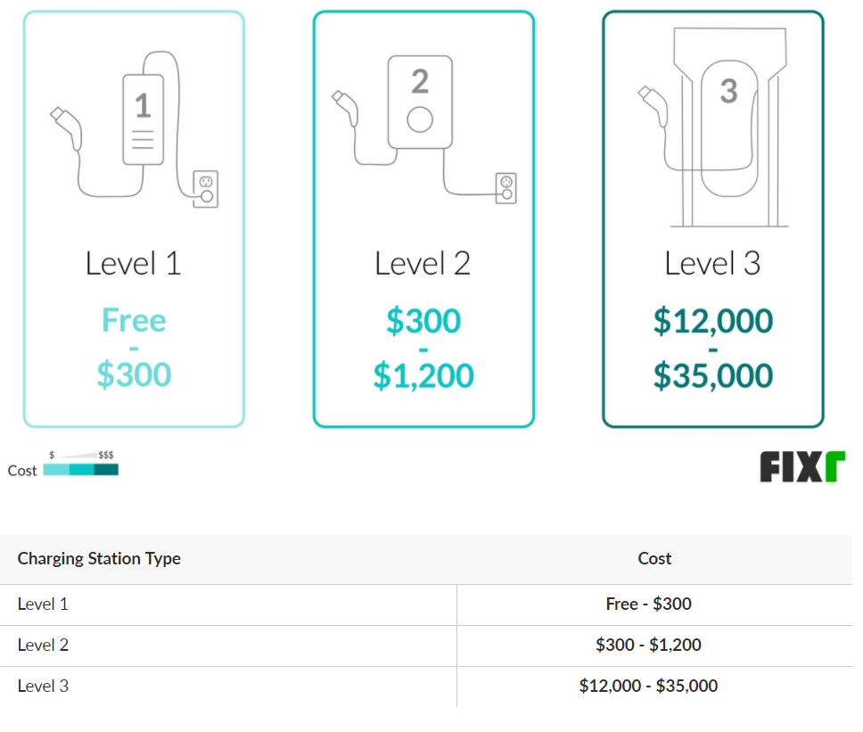
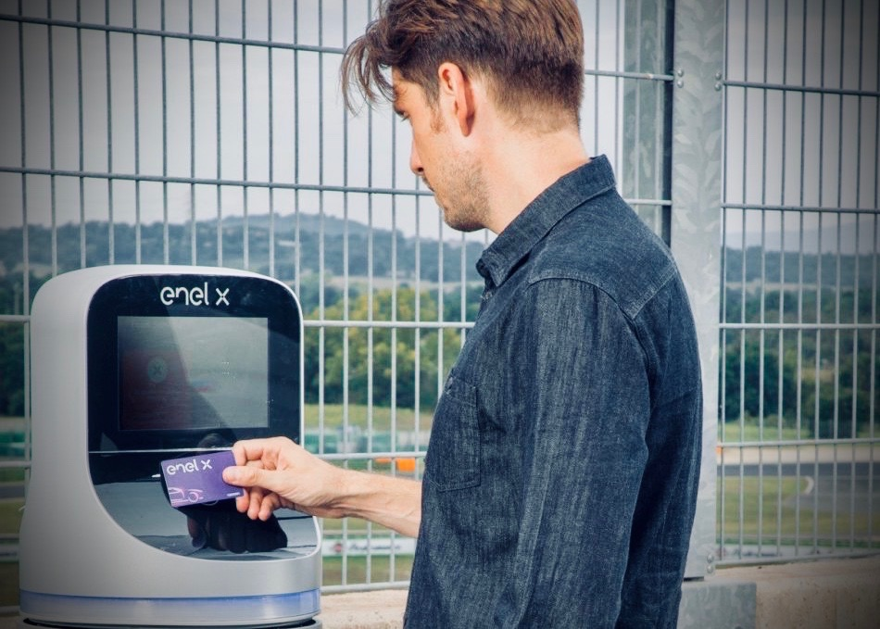
Charging station cost analysis
Installation cost + Charging price = TBD
https://www.fixr.com/costs/home-electric-vehicle-charging-station

Slide 7

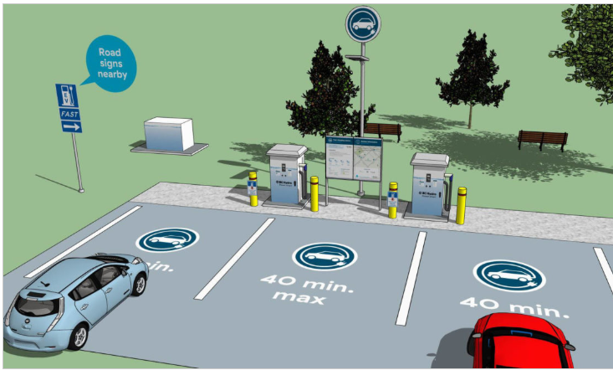

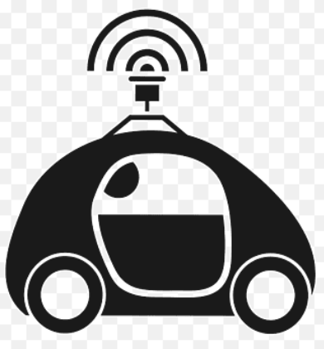

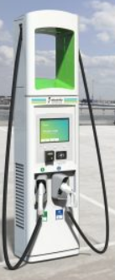
Solution: auto charging & match system (Technical)
Initial state: Car is parked
Find & Match a nearby available charging station owner & user
Autonomous Drive to a nearby available charging station
Start Auto Charging
Return Drive to original position

Slide 8
Business model

Slide 9
Development plan

Slide 10
Development plan: Auto charging system Proto-type road map
Phase 1
Autonomous Parking Assistance
Phase 2
Auto Charging Service (App)
Phase 3
Auto Charger Robot Arm

Slide 11

Autonomous Parking assistanCe

Slide 12
Purpose of the project: autonomous parking assitance
Design an Industry-level autonomous parking
Identify obstacles for autonomous parking
Seek a parking assistance service

Slide 13
Design an industry-level autonomous parking
Build a prototype autonomous vehicle
Autonomous Driving
Autonomous Parking
Create diverse parking lot environment
Seek a service that could assist autonomous vehicles a more convenient parking

Slide 14
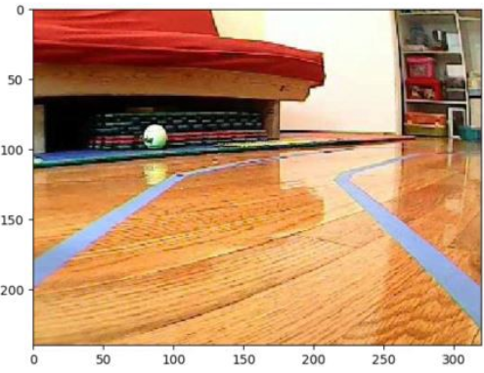
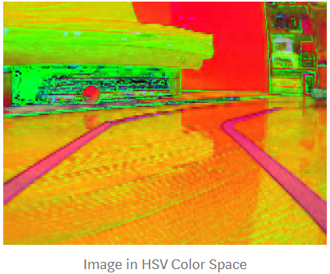
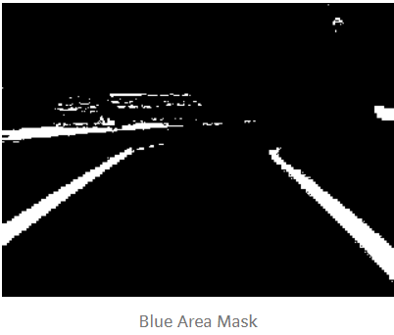
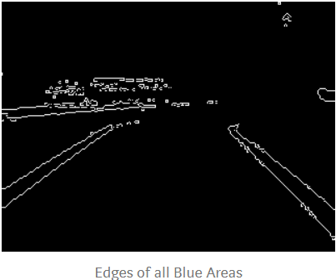
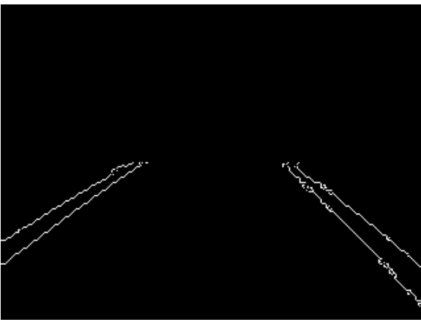
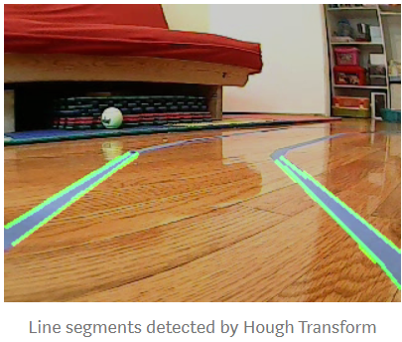
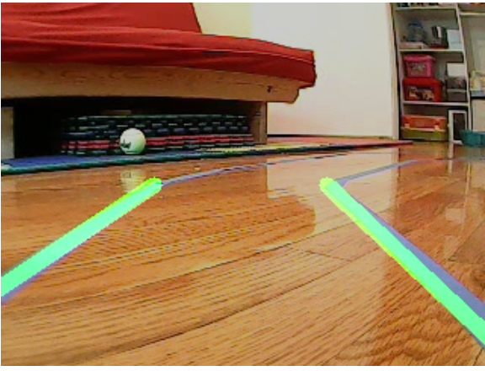
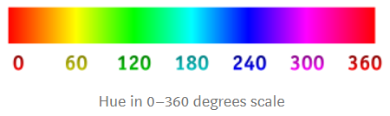
Image processing design: lane detection
Image processing algorithm (Loop Iteration)
Reads in a frame extracted from the camera module.
Convert frame into HSV color space → Create a ‘mask’ by extracting target-colored objects from the image (specifying a range of the color of ‘Lane’*)
Detect edges of lane lines → Canny Edge Detection Function (a bunch of white pixels on a black background)
Isolate Region of Interest
Detect Line Segments (extract the coordinates of these lane lines from these white pixels) → Hough Transform
Combine Line Segments into Two Lane Lines
https://towardsdatascience.com/deeppicar-part-4-lane-following-via-opencv-737dd9e47c96
*Note OpenCV uses a range of 0–180, instead of 0–360, so the blue range we need to specify in OpenCV is 60–150 (instead of 120–300).

Slide 15
Motion planning design: steering
Find a heading coordinates
= the middle of the lane
Two Detected Lane Lines
One Detected Lane Line
Convert a Heading Coordinate to a Steering Angle
Go straight = 90°;
Turn Left = 45° ~ 89°; Turn Right = 91° ~ 135°
Stabilization

Slide 16
Software design: driving mode
Driving MODE | Requried Functions & Library | Sub-func | Input | Output | Contents | Requirements | Test
Perception & Work Plan | image_lane() | detection | camer img | lane frame | Lane detection and front wheel control | end-to-end model | O
 |  | control | lane-frame | steering angle | Lane detection and front wheel control | end-to-end model
 | image_detection
 |  | detection | camera img | objects:[{obj1:{bounding_box:[],...},...],frame | object detection | Need to Define Label
 |  | contorl | objects
 |  | resume_driving | changed_car_state |  | control according to car state
 | object | is_close | frame | obj, frame_height, min_height_pct | Whether object is close | Need to Define types of objects
 |  | set_car_state | current_car_state |  | Set Current State of the car
 | openCV
Steering & Motor control
 | front_wheel | Left |  |  | Needs development
 |  | Right |  |  | Needs development
 |  | calibration
 | Back_wheel | forward
 |  | backward
 |  | calibration
 | TB6612 | stop |  |  | Motor Class(GPIO channel,PWM channel setup)
 | PCA9685 |  |  |  | pwm related module
 | smbus |  |  |  | i2c module

Slide 17
Front_wheels vs back_wheels
Front Wheels: Steering → Servo motor + shaft + wheels → PCA9685.py
Back Wheels: Propulsion → DC motors + wheels → TB6612.py

Slide 18
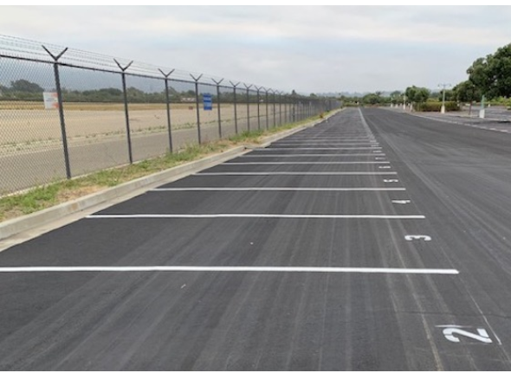
Image processing design: parking lot detection
Image processing algorithm (Loop Iteration)
TBD

Slide 19
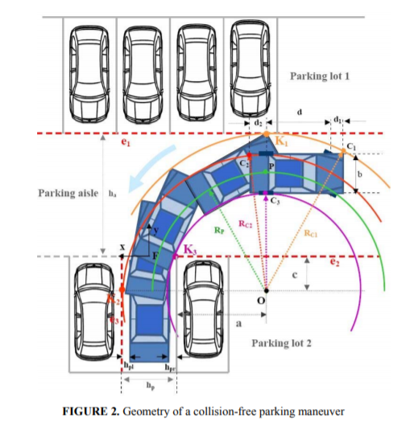
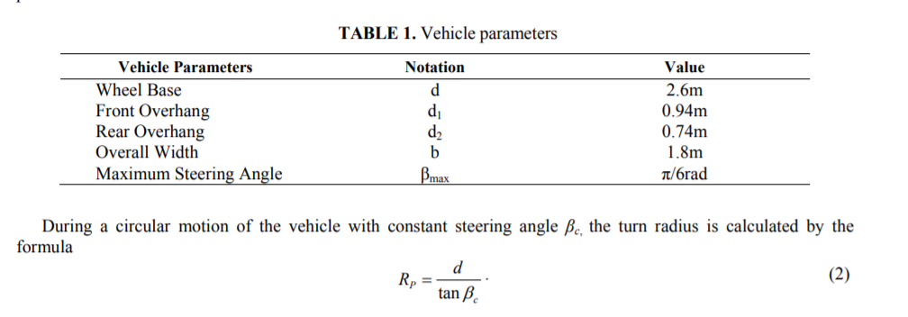
Motion planning design: parking
https://aip.scitation.org/doi/pdf/10.1063/1.5082132

Slide 20
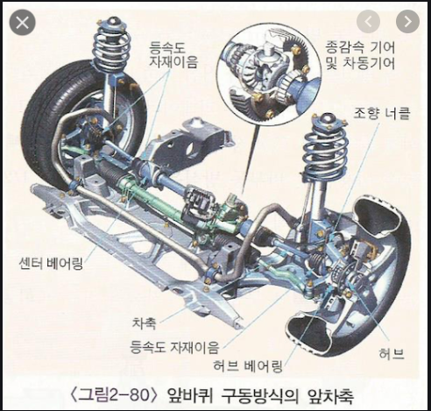
Hardware design: steering wheel
Open source 3D CAD files to print

Slide 21
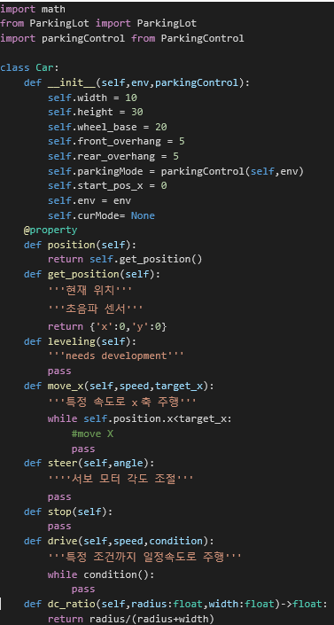
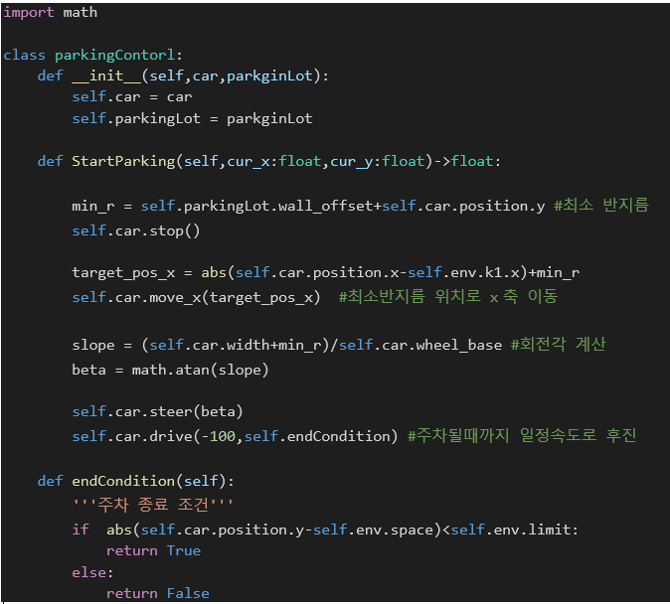
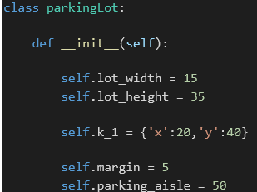
Software design
Car.py
ParkingControl.py
Parkinglot.py

Slide 22

Autocharging service app

Slide 23

Auto charger robot

Slide 24
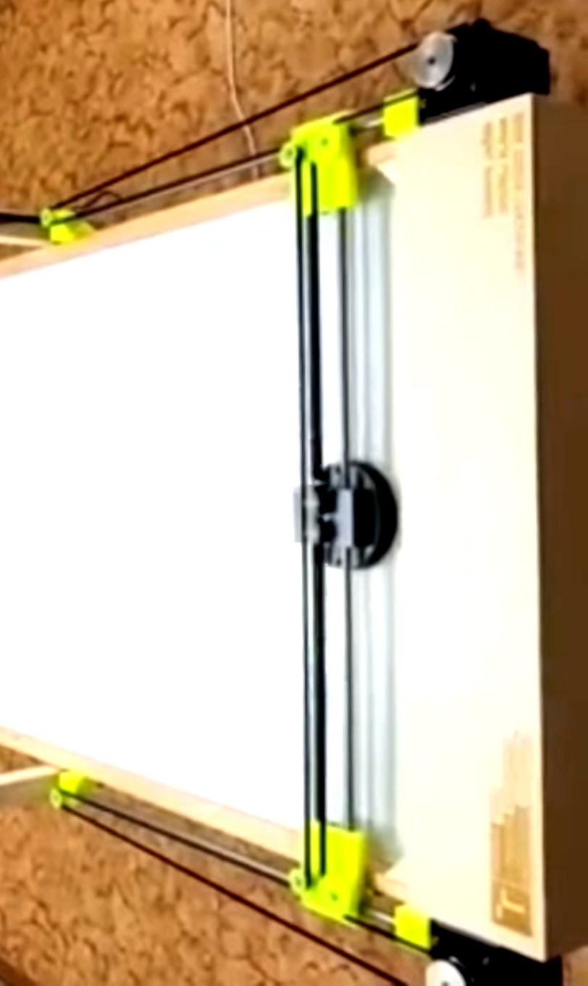
Charger robot conditions
Safety: Collaborative Robotics
Cost competitiveness
Simple design
Standardized components → Procurement, cost
Deep Learning
Identify models and their plug locations
<An Idea to consider>

Slide 25
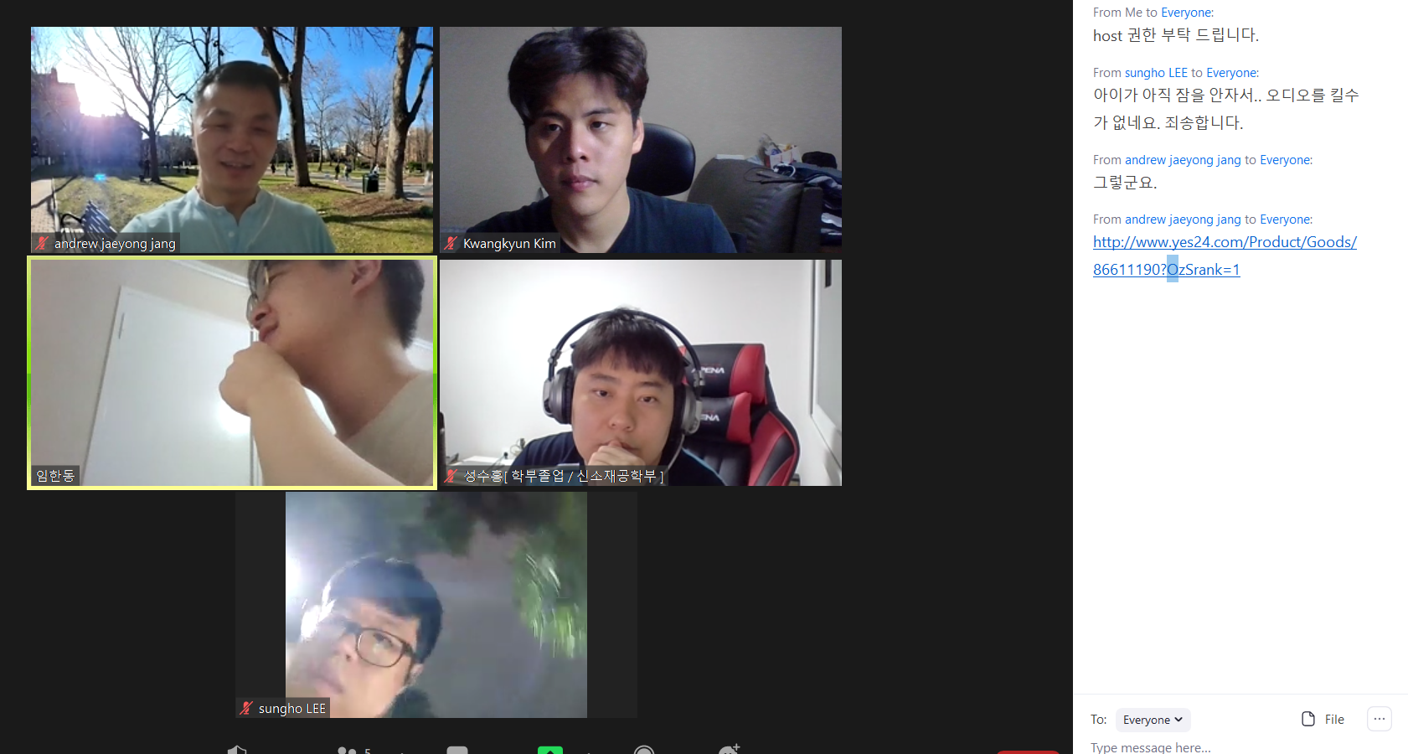

Slide 26
